Slide 1

The Evolution of the NBA
From Physical Giants to the Era of Shooters

Slide 2
Introduction
In this presentation, we’ll look at how the NBA has evolved from a physical league to one dominated by fast-paced, perimeter-oriented play
We’ll explore how the NBA’s strategic focus shifted across decades
By analyzing historical team statistics and visualizing key trends, we’ll uncover how rule changes, player influence and analytics have reshaped the modern game

Slide 3
The dataset
Source: Kaggle – “NBA ABA BAA Stats” by sumitrodatta
Time span: 1946–2020, filtered to NBA data from 1980 onward
Team-level season statistics
Key metrics:
Season
Teams
Field Goals (2P, 3P, Attempts, % of success)
Points

Slide 4
Chapter 1: The Three-Point Shot Revolution
Introduced during the season of 1980, the 3-point line had little early impact
Exponential growth in 3-point attempts over the decades
Analytics emphasized the value of 3-pointers over midrange shots
The 3-point shot became a primary offensive weapon by the 2010s

Slide 5
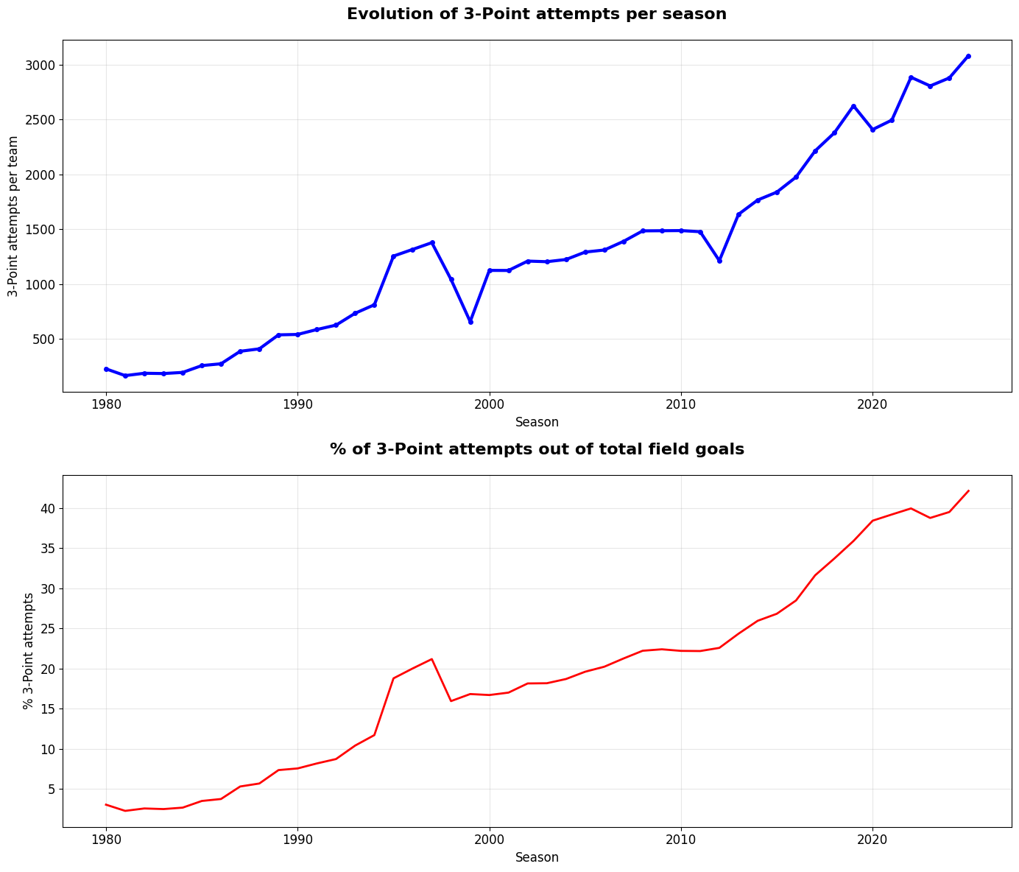
Increase in 3P attempts
Year | 3P attempts
1980 | 227.4
2020 | 2408.4
Increase: 959%

Slide 6
Chapter 2: Efficiency vs. Volume The Change in Strategy
Shift from high-volume shooting to shot efficiency
Teams prioritize points per shot, not just total attempts
Midrange game declined in favor of 3Ps
Data-driven strategy transformed offensive decision-making

Slide 7
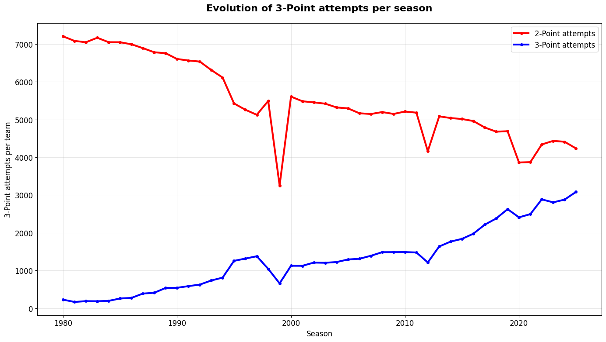
Change in Shot Distribution
Year | 2P attempts | 3P attempts
1980 | 7205.3 | 227.4
2020 | 3862.1 | 2408.4

Slide 8
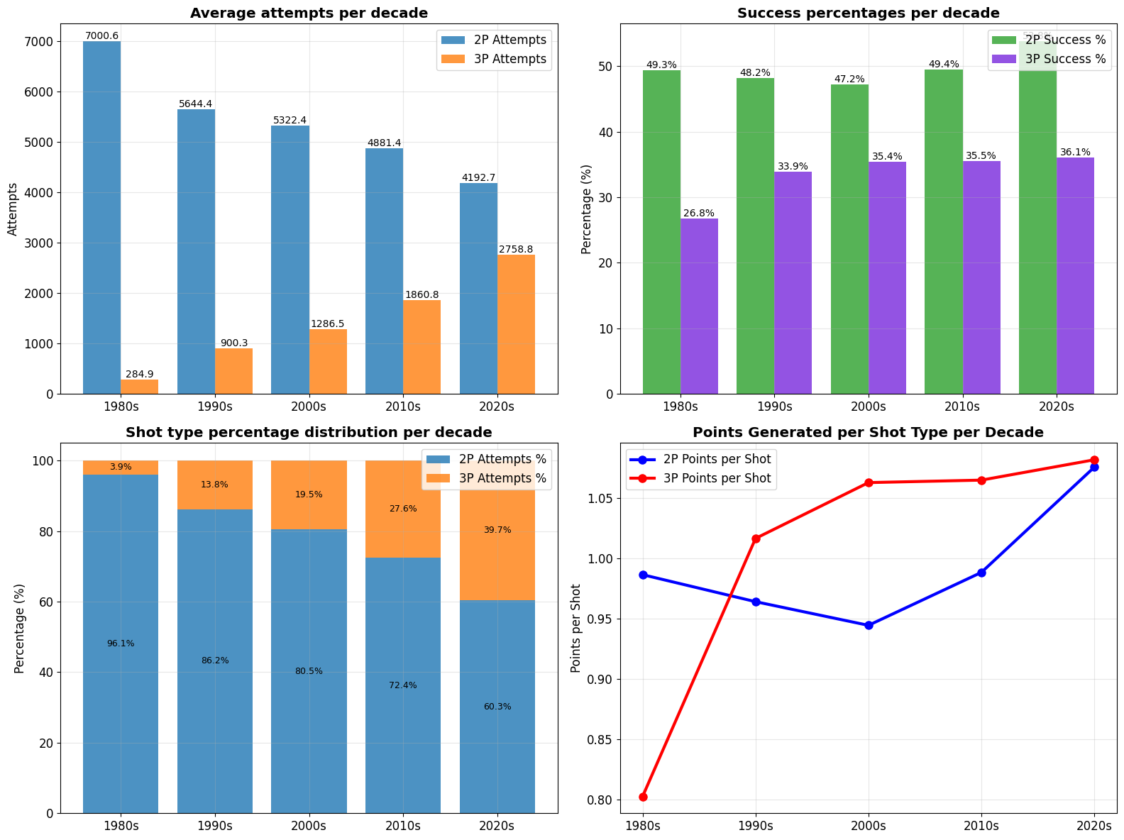

Slide 9
Chapter 3: The Transition Direct Comparison of the Physical Era vs. Technical Era
1980s–1990s (Physical Era):
Dominated by strong dominance (dunk-centric), and physical defense
Fewer possessions, slower pace
Limited reliance on the 3-point shot
2010s–2020s (Technical Era):
High pace, fluid ball movement, emphasis on spacing
Heavy use of 3-pointers
Positional versatility and skill over size

Slide 10
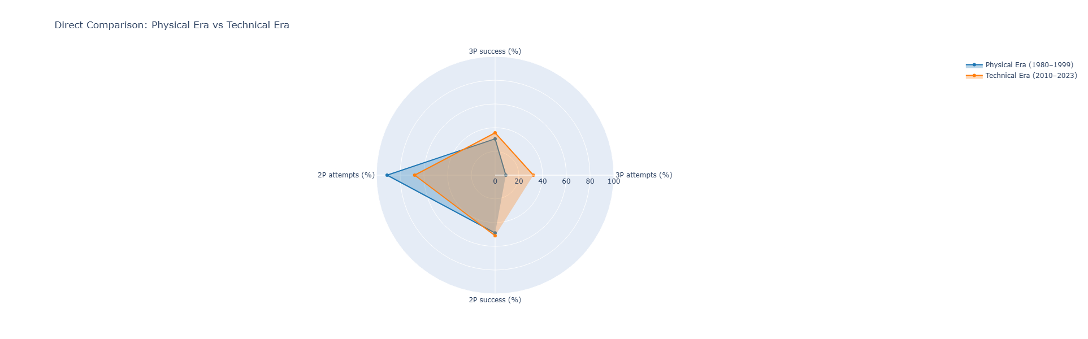
Comparison of the eras
Metric | Physical era | Technical era
% 2P attempts | 91% | 67.8%
% 3P attempts | 9% | 32.2%
% 2P success | 48.7% | 51.1%
% 3P success | 30.6% | 35.7%

Slide 11
Chapter 4: The Impact on Efficiency More 3-Pointers = More Points?
Dramatic increase in 3-point attempts since the 2010s
Offensive ratings have steadily improved
3-point shot improves scoring efficiency, not just total volume
Strong correlation between 3P usage and offensive output

Slide 12
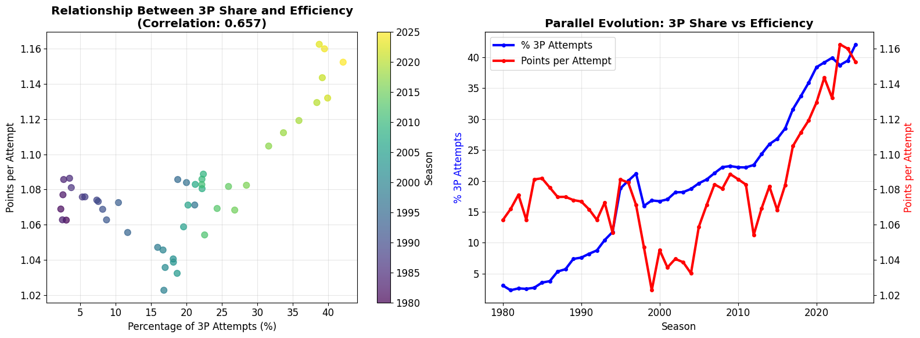
Positive correlation = as one variable increases, so does the other
In this case, fairly strong tendency for points per attempt to increase as the % of 3P attempts increases

Slide 13
Chapter 5: Case Study - The Curry Era
Stephen Curry revolutionized 3-point shooting (especially post-2015)
His range and volume normalized deep shooting league-wide
"Moreyball" philosophy emphasized 3s & layups, Curry brought it to life
Influenced team construction, spacing, and shot selection
League-wide 3PA spiked during Golden State’s peak dominance

Slide 14
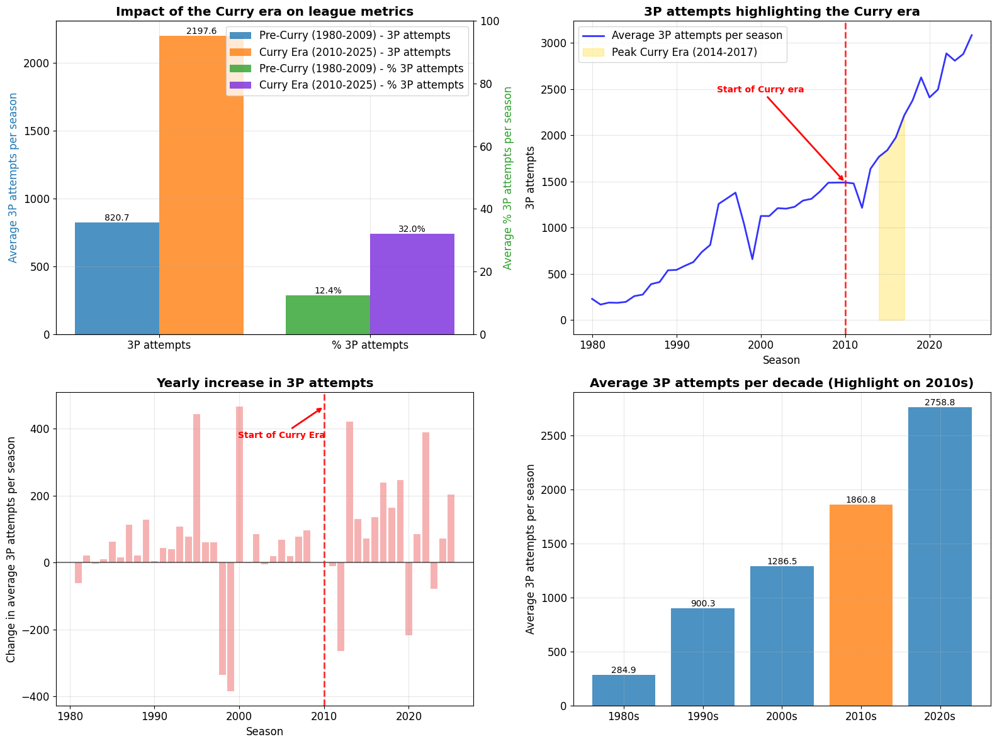

Slide 15
Conclusion
The NBA has undergone a dramatic stylistic shift
From physical, low-range plays to fast-paced, perimeter-focused offense
Strategy evolved towards efficiency (more 3Ps, less midrange shots)
Stephen Curry fully incarnated and influenced this transition, making deep shooting more mainstream
Analytics played a central role, guiding teams to smarter shooting selection
Today, the modern NBA is a game of space, speed and precision

